Slide 1
Moving around the Filesystem

Slide 2
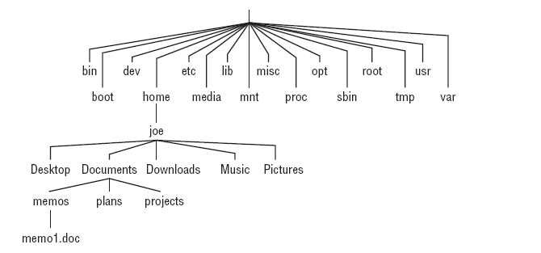
The Linux filesystem
The Linux filesystem is organized as a hierarchy of directories

Slide 3
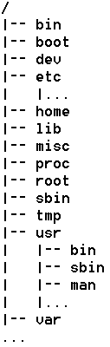
Linux 的目录结构
文件系统结构的起始位置，称为根
存放基本命令程序(任何用户都可以调用)
存放系统启动时所读取的文件，包括系统核心文件
存放设备文件接口，如打印机、硬盘等外围设备
存放与系统设置和管理相关的文件，如用户帐号、密码等
存放用户专属目录（用户主目录）
存放一些共享的函数库
一个空目录，供管理员存放公共杂物
存放系统核心和执行程序之间的信息
系统管理员（超级用户）专用目录
与/bin类似，存放用于系统引导和管理命令，通常供root使用。
临时目录，供任何用户存放临时文件。
此目录包含许多子目录，用来存放系统命令和程序等信息
存放经常变动的文件，如日志文件、临时文件、电子邮件等

Slide 4
Linux Filesystems versus Windows-Based Filesystems
drive letters(windows)
Slashes vs. backslashes
File suffixes
Every file and directory in a Linux system has permissions and ownership associated with it.

Slide 5
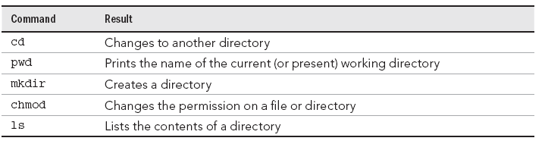
Using Basic Filesystem Commands

Slide 6
其他命令
  ln
  gzip, gunzip……
  Tar
  find
  touch

Slide 7
Pathname
  absolute pathname
  relative pathname
home Directory
current directory
Special character
  tilde (~)
  two dots (..)
  One dit(.)

Slide 8
cd [directory]
  cd ~
  cd
  cd ..
pwd

Slide 9
Make directory
mkdir [option] [dirnames]
rmdir [option] dirnames
  -p
mkdir /lhome/lrj/mybin
mkdir -p mydoc/FAQ

Slide 10
Using Metacharacters and Operators
*—Matches any number of characters.
?—Matches any one character.
[...]—Matches any one of the characters between the brackets, which caninclude a hyphen-separated range of letters or numbers.

Slide 11
$ touch apple banana grape grapefruit watermelon
ls a*
ls g*
ls *e*
ls *n*
ls ????e
ls g???e*
ls [abw]*
ls [agw]*[ne]

Slide 12
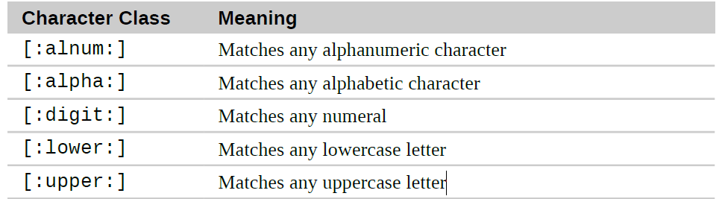
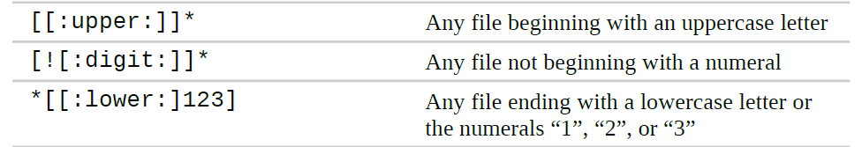
[[:class:]] Matches any character that is a member of the specified class

Slide 13

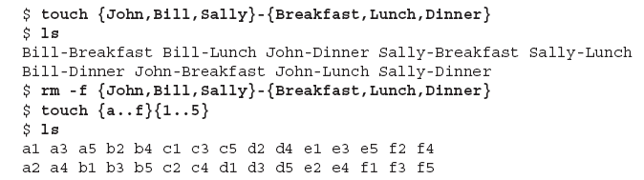
Using brace expansion characters

Slide 14
Listing Files and Directories
ls [option] [pathname-list]
  -l file details
  -F list files and append file-type indicators
  -a show hidden and non-hidden files
  -t list files by time most recently modified
  --hide= option
  -R list all files and directories recursively
  from current directory down
  -S list fi les by size

Slide 15
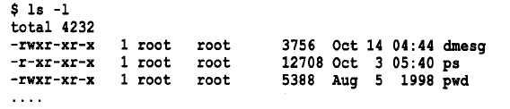
d 目录。
l 符号链接(指向另一个文件)。
s 套接字文件。
b 块设备文件。
c 字符设备文件。
p 命名管道文件。
- 普通文件，或者更准确地说，不属于以上几种类型的文件。

Slide 16
ls -l ~/courses/ee446/lab[!5]*.c
ls ~/[!0-9]*.[c,C]
ls [a-zA-Z]??[1-5].html

Slide 17
Moving, Copying, and Removing Files
cp [option] file1 file2
cp [option] file…file targetdir
cp [option] sourcedir… targetdir
  -a Preserve the specified attributes
  -i Prompt before overwrite
  R Copy directories recursively
  -r
  --recursive

Slide 18
$ cp abc def
$ cp abc ~
$ cp -r /usr/share/doc/bash-completion* /tmp/a/
$ cp -ra /usr/share/doc/bash-completion* /tmp/b/

Slide 19
mv [option] file1 file2
mv [option] file-list target dir
mv [option] dir1 dir2
  -i, --interactive
  -f Do not prompt before overwriting existing
  files.
  v, --verbose

Slide 20
$ mv abc def
$ mv abc ~
$ mv /home/joe/mymemos/ /home/joe/Documents/

Slide 21
rm [option] ‘file-list’
  -r
  -f
  -i

Slide 22
Linux links
  Hard Links
  Symbolic(soft) Links

Slide 23
目录~/course的内容
i-node表
2083 | …..
17448 | Chapter2
52473 | Chapter3
. . .
. . .
i-node0
i-node52473
链接数 大小 被更新日期 所有者 . . . 文件在磁盘上的位置

Slide 24
ln – Create Links
  ln file link
  ln -s item link

Slide 25
Hard links have two important limitations:
  A hard link cannot reference a file outside its own file system. This means a link cannot reference a file that is not on the same disk partition as the link itself.
  A hard link may not reference a directory

Slide 26
compression
gzip Compression
  The gzip program is used to compress one or more files.
  When executed, it replaces the original file with a compressed version of the original.
  The corresponding gunzip program is used to restore compressed files to their original, uncompressed form.
  A file compressed with gzip is denoted with the extension .gz

Slide 27
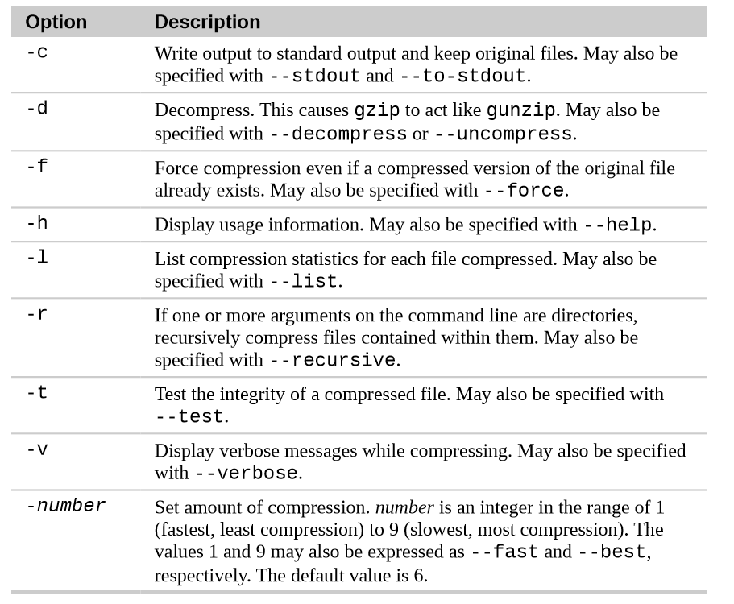

Slide 28
  gzip foo.txt
  gunzip foo.txt
  gzip foo.txt
  gzip -tv foo.txt.gz
  gzip -d foo.txt.gz

Slide 29
bzip2
  The bzip2 program is similar to gzip, but uses a different compression algorithm that achieves higher levels of compression at the cost of compression speed.
  In most regards, it works in the same fashion as gzip.
  A file compressed with bzip2 is denoted with the extension .bz2

Slide 30
  bzip2 foo.txt
  bunzip2 foo.txt.bz2
  bzip2 –d foo.txt.bz2

Slide 31
Archiving Files
  Archiving is the process of gathering up many files and bundling them together into a single large file.
  Archiving is often done as a part of system backups.
  It is also used when old data is moved from a system to some type of long-term storage.

Slide 32
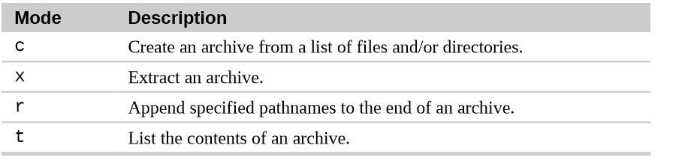
  tar mode[options] pathname...
-f, --file=ARCHIVE Use archive file (or device) ARCHIVE.
-z, --gzip, --gunzip This option tells tar to read or write archives through gzip,
-v, --verbose Operate verbosely.

Slide 33
$ tar -cvf myball.tar somedirname
$ tar -tf myball.tar
$ tar -xvf myball.tar
$ tar -zcvf myball.tar.gz somedirname
$ tar -ztf myball.tar.gz
$ tar -zxvf myball.tar.gz
$ tar -jcvf myball.tar.bz2 somedirname
$ tar -jtf myball.tar.bz2
$ tar -jxvf myball.tar.bz2

